Slide 1
Other dependent clauses
Nick Riches
Homework
Other types of DC
Adv. cl. recap Other types
Other dependent clauses
DCs as comp. of vb.
Od and Oi position The SOMETHING test Cs and Co position EXERCISE
Subordinators EXERCISE
Nick Riches
Newcastle University
DCs in Subj.Posn.
Example
Heavy phrase shift EXERCISE
March 17, 2020
DCs in P-mod
What is a P-mod? Post-modifying clauses
Focus on RCs
Examples
Girls who are boys. . . Res./non-res. dist. Properties of RCs
Relative clauses in research EXERCISE
Homework
1 / 51

Slide 2
Other dependent clauses
Nick Riches
Homework
Other types of dependent clause
Homework
Other types of DC
Adv. cl. recap Other types
Dependent clauses as a complement of the verb (Od, Oi, Cs, Co)
DCs as comp. of vb.
Od and Oi position The SOMETHING test Cs and Co position EXERCISE
Subordinators EXERCISE
Dependent clauses in Subject Position
Dependent clauses in Post-modifer Position
DCs in Subj.Posn.
Example
Heavy phrase shift EXERCISE
Focus on relative clauses Homework
DCs in P-mod
What is a P-mod? Post-modifying clauses
Bibliography
Focus on RCs
Examples
Girls who are boys. . . Res./non-res. dist. Properties of RCs
Relative clauses in research EXERCISE
Homework
1 / 51

Slide 3
Other dependent clauses
Nick Riches
Homework
Other types of DC
Adv. cl. recap Other types
Girls and Boys, by Blur
DCs as comp. of vb.
Od and Oi position The SOMETHING test Cs and Co position EXERCISE
Subordinators EXERCISE
(We’re) Looking for Girls who are boys Who like boys to be girls
Who do boys like they’re girls Who do girls like they’re boys.
Always should be someone you really love.
DCs in Subj.Posn.
Example
Heavy phrase shift EXERCISE
DCs in P-mod
What is a P-mod?
Post-modifying clauses
Focus on RCs
Examples
Girls who are boys. . . Res./non-res. dist. Properties of RCs
Relative clauses in research EXERCISE
Homework
2 / 51

Slide 4
Other dependent clauses
Nick Riches
Homework
Other types of DC
Adv. cl. recap Other types
(We’re) Looking for Girls who are boys Who like boys to be girls
Who do boys like they’re girls Who do girls like they’re boys.
Always should be someone you really love.
DCs as comp. of vb.
Od and Oi position The SOMETHING test Cs and Co position EXERCISE
Subordinators EXERCISE
DCs in Subj.Posn.
Example
Heavy phrase shift EXERCISE
DCs in P-mod
What is a P-mod?
Post-modifying clauses
Focus on RCs
Examples
Girls who are boys. . . Res./non-res. dist. Properties of RCs
Relative clauses in research EXERCISE
Homework
3 / 51

Slide 5
Other dependent clauses
Nick Riches
Homework
Other types of dependent clause
Homework
Other types of DC
Adv. cl. recap Other types
Dependent clauses as a complement of the verb (Od, Oi, Cs, Co)
DCs as comp. of vb.
Od and Oi position The SOMETHING test Cs and Co position EXERCISE
Subordinators EXERCISE
Dependent clauses in Subject Position
Dependent clauses in Post-modifer Position
DCs in Subj.Posn.
Example
Heavy phrase shift EXERCISE
Focus on relative clauses Homework
DCs in P-mod
What is a P-mod?
Post-modifying clauses
Bibliography
Focus on RCs
Examples
Girls who are boys. . . Res./non-res. dist. Properties of RCs
Relative clauses in research EXERCISE
Homework
3 / 51

Slide 6
Recap on adverbial clauses
Other dependent clauses
Nick Riches
Homework
Other types of DC
Adv. cl. recap Other types
Sentence
DCs as comp. of vb.
Od and Oi position The SOMETHING test Cs and Co position EXERCISE
Subordinators EXERCISE
Adverbial
Clause
Sub. Clause
it will be forever
DCs in Subj.Posn.
Example
Heavy phrase shift EXERCISE
When I fall in love
DCs in P-mod
What is a P-mod?
Post-modifying clauses
Focus on RCs
Examples
Girls who are boys. . . Res./non-res. dist. Properties of RCs
Relative clauses in research EXERCISE
Homework
4 / 51

Slide 7
Other types
Other dependent clauses
Nick Riches
Homework
Other types of DC
Adv. cl. recap Other types
DCs as comp. of vb.
Od and Oi position The SOMETHING test Cs and Co position EXERCISE
Subordinators EXERCISE
Dependent clauses can come inside any other function: S, Od, Oi, Cs, Co, P-Mod
DCs in Subj.Posn.
Example
Heavy phrase shift EXERCISE
DCs in P-mod
What is a P-mod? Post-modifying clauses
Focus on RCs
Examples
Girls who are boys. . . Res./non-res. dist. Properties of RCs
Relative clauses in research EXERCISE
Homework
5 / 51

Slide 8
Other dependent clauses
Nick Riches
Homework
Other types of dependent clause
Homework
Other types of DC
Adv. cl. recap Other types
Dependent clauses as a complement of the verb (Od, Oi, Cs, Co)
DCs as comp. of vb.
Od and Oi position The SOMETHING test Cs and Co position EXERCISE
Subordinators EXERCISE
Dependent clauses in Subject Position
Dependent clauses in Post-modifer Position
DCs in Subj.Posn.
Example
Heavy phrase shift EXERCISE
Focus on relative clauses Homework
DCs in P-mod
What is a P-mod? Post-modifying clauses
Bibliography
Focus on RCs
Examples
Girls who are boys. . . Res./non-res. dist. Properties of RCs
Relative clauses in research EXERCISE
Homework
5 / 51

Slide 9

Od and Oi position
Other dependent clauses
Nick Riches
Sentence
Homework
Other types of DC
Adv. cl. recap Other types
A
Clause
DCs as comp. of vb.
Od and Oi position The SOMETHING test Cs and Co position EXERCISE
Subordinators EXERCISE
Last night NP
VP
I
V
Clause=Od
DCs in Subj.Posn.
Example
Heavy phrase shift EXERCISE
dreamt
somebody loved me
DCs in P-mod
What is a P-mod? Post-modifying clauses
Focus on RCs
Examples
Girls who are boys. . . Res./non-res. dist. Properties of RCs
Relative clauses in research EXERCISE
Homework
6 / 51

Slide 10

Od and Oi position
Other dependent clauses
Nick Riches
Sentence
Homework
Other types of DC
Adv. cl. recap Other types
NP
AuxP
DCs as comp. of vb.
Od and Oi position The SOMETHING test Cs and Co position EXERCISE
Subordinators EXERCISE
I ’ll
VP
V N=Oi Clause=Od
DCs in Subj.Posn.
Example
Heavy phrase shift EXERCISE
tell you
what I want
DCs in P-mod
What is a P-mod? Post-modifying clauses
Focus on RCs
Examples
Girls who are boys. . . Res./non-res. dist. Properties of RCs
Relative clauses in research EXERCISE
Homework ^{7 / 51}

Slide 11
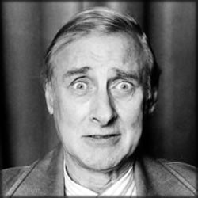
Od and Oi position
Other dependent clauses
Nick Riches
Sentence
Homework
Other types of DC
Adv. cl. recap Other types
NP
VP
DCs as comp. of vb.
Od and Oi position The SOMETHING test Cs and Co position EXERCISE
Subordinators EXERCISE
I
V N=Oi
Clause=Od
told you
I was ill
DCs in Subj.Posn.
Example
Heavy phrase shift EXERCISE
DCs in P-mod
What is a P-mod? Post-modifying clauses
Focus on RCs
Examples
Girls who are boys. . . Res./non-res. dist. Properties of RCs
Relative clauses in research EXERCISE
Homework ^{8 / 51}

Slide 12
The SOMETHING test
Other dependent clauses
Nick Riches
Homework
Other types of DC
Adv. cl. recap Other types
It may be easier to see the function of the dependent clause if you substitute it with ‘something’, ‘somebody’ etc.
(1) Last night I dreamt SOMETHING → that somebody
DCs as comp. of vb.
Od and Oi position The SOMETHING test Cs and Co position EXERCISE
Subordinators EXERCISE
loved me
DCs in Subj.Posn.
Example
Heavy phrase shift EXERCISE
I’ll tell you SOMETHING → what I want
I told you SOMETHING → I was ill.
DCs in P-mod
What is a P-mod? Post-modifying clauses
Focus on RCs
Examples
Girls who are boys. . . Res./non-res. dist. Properties of RCs
Relative clauses in research EXERCISE
Homework ^{9 / 51}

Slide 13

Cs and Co position
Other dependent clauses
Nick Riches
Money . . .
Homework
Other types of DC
Adv. cl. recap Other types
Sentence
NP VP
That V Clause=Cs
DCs as comp. of vb.
Od and Oi position The SOMETHING test Cs and Co position EXERCISE
Subordinators EXERCISE
DCs in Subj.Posn.
Example
Heavy phrase shift EXERCISE
’s what I want
DCs in P-mod
What is a P-mod? Post-modifying clauses
Focus on RCs
Examples
Girls who are boys. . . Res./non-res. dist. Properties of RCs
Relative clauses in research EXERCISE
Homework ^{10 / 51}

Slide 14
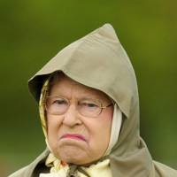
Cs and Co position
Other dependent clauses
Nick Riches
Sentence
Homework
Other types of DC
Adv. cl. recap Other types
NP
AuxP
DCs as comp. of vb.
Od and Oi position The SOMETHING test Cs and Co position EXERCISE
Subordinators EXERCISE
I Aux
VP
will V NP=Od
Clause=Co
DCs in Subj.Posn.
Example
Heavy phrase shift EXERCISE
name
this ship
anything I want
DCs in P-mod
What is a P-mod? Post-modifying clauses
Focus on RCs
Examples
Girls who are boys. . . Res./non-res. dist. Properties of RCs
Relative clauses in research EXERCISE
Homework ^{11 / 51}

Slide 15
EXERCISE
Other dependent clauses
Nick Riches
Homework
Other types of DC
Adv. cl. recap Other types
Identify the subordinate clauses in the following sentences. What is their function?
DCs as comp. of vb.
Od and Oi position The SOMETHING test Cs and Co position EXERCISE
Subordinators EXERCISE
I think I’m going crazy
Give the food to whoever wants it
You are everything I’d want in a woman
I like that she never loses her cool
You can be whoever you want to be
DCs in Subj.Posn.
Example
Heavy phrase shift EXERCISE
DCs in P-mod
What is a P-mod? Post-modifying clauses
Focus on RCs
Examples
Girls who are boys. . . Res./non-res. dist. Properties of RCs
Relative clauses in research EXERCISE
Homework ^{12 / 51}

Slide 16
EXERCISE
Other dependent clauses
Nick Riches
Homework
Other types of DC
Adv. cl. recap Other types
Identify the dependent clauses in the following sentences:
DCs as comp. of vb.
Od and Oi position The SOMETHING test Cs and Co position EXERCISE
Subordinators EXERCISE
I think I’m going crazy : Od
Give the food to whoever wants it : Oi
You are everything I’d want in a woman : Cs
I like that she never loses her cool : Od
You can be whoever you want to be : Cs
DCs in Subj.Posn.
Example
Heavy phrase shift EXERCISE
DCs in P-mod
What is a P-mod? Post-modifying clauses
Focus on RCs
Examples
Girls who are boys. . . Res./non-res. dist. Properties of RCs
Relative clauses in research EXERCISE
Homework ^{13 / 51}

Slide 17
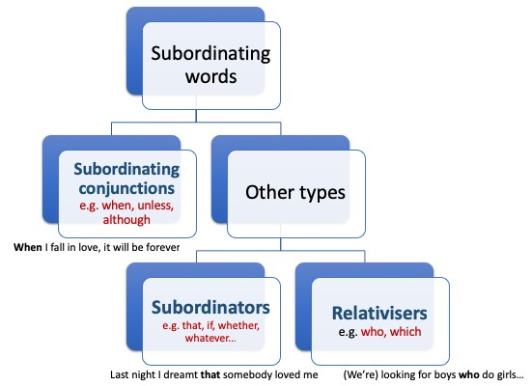
Subordinators
Other dependent clauses
Nick Riches
Homework
Other types of DC
Adv. cl. recap Other types
DCs as comp. of vb.
Od and Oi position The SOMETHING test Cs and Co position EXERCISE
Subordinators EXERCISE
DCs in Subj.Posn.
Example
Heavy phrase shift EXERCISE
DCs in P-mod
What is a P-mod? Post-modifying clauses
Focus on RCs
Examples
Girls who are boys. . . Res./non-res. dist. Properties of RCs
Relative clauses in research EXERCISE
NB all are labelled s under the LARSP framework.
Homework ^{14 / 51}

Slide 18
Subordinators
Other dependent clauses
Nick Riches
Homework
Other types of DC
Adv. cl. recap Other types
The subordinating conjunction introduces a dependent (subordinate) clause inside an ADVERBIAL
DCs as comp. of vb.
Od and Oi position The SOMETHING test Cs and Co position EXERCISE
Subordinators EXERCISE
(4) [ When [ I fall in love _{Cl.} ] _{ADV} ] it will be forever
A subordinator introduces a dependent (subordinate) clause in other functions (S, Od, Oi, Cs, Co, P-mod)
(5) Last night I dreamt
DCs in Subj.Posn.
Example
Heavy phrase shift EXERCISE
DCs in P-mod
What is a P-mod? Post-modifying clauses
[ that [ somebody loved me ] ]
Cl. Od
Focus on RCs
Examples
Girls who are boys. . . Res./non-res. dist. Properties of RCs
Relative clauses in research EXERCISE
Homework ^{15 / 51}

Slide 19
Subordinators
Other dependent clauses
Nick Riches
Subordinators are less successful ‘pickup trucks’ than subordinating conjunctions.
Homework
Other types of DC
Adv. cl. recap Other types
Movement
DCs as comp. of vb.
Od and Oi position The SOMETHING test Cs and Co position EXERCISE
Subordinators EXERCISE
t It will be forever
When I fall in love
(6)
Movement
That somebody loved me I dreamt t
Movement
What I want I’ll tell you t
DCs in Subj.Posn.
Example
Heavy phrase shift EXERCISE
(7) ??
DCs in P-mod
What is a P-mod? Post-modifying clauses
Focus on RCs
Examples
(8) ??
Girls who are boys. . .
Res./non-res. dist. Properties of RCs
Relative clauses in research EXERCISE
Homework ^{16 / 51}

Slide 20
Subordinators
Other dependent clauses
Nick Riches
Money, It’s . . .
NP
Homework
Other types of DC
Adv. cl. recap Other types
NP
clause
DCs as comp. of vb.
Od and Oi position The SOMETHING test Cs and Co position EXERCISE
Subordinators EXERCISE
what NP
VP
I
V NP
DCs in Subj.Posn.
Example
Heavy phrase shift EXERCISE
want t
DCs in P-mod
What is a P-mod? Post-modifying clauses
Focus on RCs
Examples
Girls who are boys. . . Res./non-res. dist. Properties of RCs
Relative clauses in research EXERCISE
Could be classified as a subordinator (because it has a subordinating function), or pronoun (because it stands in place of a moved NP)
Homework ^{17 / 51}

Slide 21
Subordinators
Other dependent clauses
Nick Riches
I’ll name this ship . . .
Homework
Other types of DC
Adv. cl. recap Other types
NP
DCs as comp. of vb.
Od and Oi position The SOMETHING test Cs and Co position EXERCISE
Subordinators EXERCISE
NP
clause
whatever NP
VP
DCs in Subj.Posn.
Example
Heavy phrase shift EXERCISE
I
V NP
DCs in P-mod
What is a P-mod? Post-modifying clauses
want t
Focus on RCs
Examples
Girls who are boys. . . Res./non-res. dist. Properties of RCs
Relative clauses in research EXERCISE
Homework ^{18 / 51}

Slide 22
Subordinators
Other dependent clauses
Nick Riches
Homework
Other types of DC
Adv. cl. recap Other types
DCs as comp. of vb.
Od and Oi position The SOMETHING test Cs and Co position EXERCISE
Subordinators EXERCISE
But not all subordinators behave like this . . . Last night I dreamt (that) somebody loved me.
DCs in Subj.Posn.
Example
Heavy phrase shift EXERCISE
DCs in P-mod
What is a P-mod?
Post-modifying clauses
Focus on RCs
Examples
Girls who are boys. . . Res./non-res. dist. Properties of RCs
Relative clauses in research EXERCISE
Homework ^{19 / 51}

Slide 23
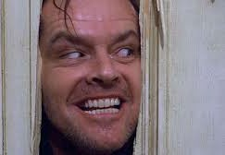
Subordinators
Other dependent clauses
Nick Riches
Homework
Other types of DC
Adv. cl. recap Other types
DCs as comp. of vb.
Od and Oi position The SOMETHING test Cs and Co position EXERCISE
Subordinators EXERCISE
that somebody loved me
DCs in Subj.Posn.
Example
Heavy phrase shift EXERCISE
DCs in P-mod
What is a P-mod? Post-modifying clauses
Focus on RCs
Examples
what I want
Girls who are boys. . .
Res./non-res. dist. Properties of RCs
Relative clauses in research EXERCISE
Homework ^{20 / 51}

Slide 24
EXERCISE
Other dependent clauses
Nick Riches
Homework
Other types of DC
Adv. cl. recap Other types
Add subordinating words to the following sentences. In which cases are the subordinating words optional?
DCs as comp. of vb.
Od and Oi position The SOMETHING test Cs and Co position EXERCISE
Subordinators EXERCISE
He said he was working very hard
You come to the party is no concern of mine
The house he bought was falling apart
I still don’t know the reason he dropped out of school
DCs in Subj.Posn.
Example
Heavy phrase shift EXERCISE
DCs in P-mod
What is a P-mod?
Post-modifying clauses
Focus on RCs
Examples
Girls who are boys. . . Res./non-res. dist. Properties of RCs
Relative clauses in research EXERCISE
Homework ^{21 / 51}

Slide 25
EXERCISE
Other dependent clauses
Nick Riches
Homework
Other types of DC
Adv. cl. recap Other types
Add subordinating words to the following sentences. In which cases are the subordinating words optional?
DCs as comp. of vb.
Od and Oi position The SOMETHING test Cs and Co position EXERCISE
Subordinators EXERCISE
1. He said that he was working very hard
DCs in Subj.Posn.
Example
Heavy phrase shift EXERCISE
DCs in P-mod
What is a P-mod?
Post-modifying clauses
Focus on RCs
Examples
Girls who are boys. . . Res./non-res. dist. Properties of RCs
Relative clauses in research EXERCISE
Homework ^{22 / 51}

Slide 26
EXERCISE
Other dependent clauses
Nick Riches
Homework
Other types of DC
Adv. cl. recap Other types
Add subordinating words to the following sentences. In which cases are the subordinating words optional?
DCs as comp. of vb.
Od and Oi position The SOMETHING test Cs and Co position EXERCISE
Subordinators EXERCISE
1. He said
he was working very hard
you come to the party is no concern of mine
that
2.
Whether
DCs in Subj.Posn.
Example
Heavy phrase shift EXERCISE
DCs in P-mod
What is a P-mod? Post-modifying clauses
Focus on RCs
Examples
Girls who are boys. . . Res./non-res. dist. Properties of RCs
Relative clauses in research EXERCISE
Homework ^{22 / 51}

Slide 27
EXERCISE
Other dependent clauses
Nick Riches
Homework
Other types of DC
Adv. cl. recap Other types
Add subordinating words to the following sentences. In which cases are the subordinating words optional?
DCs as comp. of vb.
Od and Oi position The SOMETHING test Cs and Co position EXERCISE
Subordinators EXERCISE
he was working very hard
2. Whether you come to the party is no concern of mine
1. He said
that
3. The house he bought was falling apart
DCs in Subj.Posn.
Example
Heavy phrase shift EXERCISE
that/which
DCs in P-mod
What is a P-mod? Post-modifying clauses
Focus on RCs
Examples
Girls who are boys. . . Res./non-res. dist. Properties of RCs
Relative clauses in research EXERCISE
Homework ^{22 / 51}

Slide 28
EXERCISE
Other dependent clauses
Nick Riches
Homework
Other types of DC
Adv. cl. recap Other types
Add subordinating words to the following sentences. In which cases are the subordinating words optional?
DCs as comp. of vb.
Od and Oi position The SOMETHING test Cs and Co position EXERCISE
Subordinators EXERCISE
1. He said that he was working very hard
2. Whether you come to the party is no concern of mine
3. The house that/which he bought was falling apart
DCs in Subj.Posn.
Example
Heavy phrase shift EXERCISE
4. I still don’t know the reason why he dropped out of school
DCs in P-mod
What is a P-mod?
Post-modifying clauses
Focus on RCs
Examples
Girls who are boys. . . Res./non-res. dist. Properties of RCs
Relative clauses in research EXERCISE
Homework ^{22 / 51}

Slide 29
EXERCISE
Other dependent clauses
Nick Riches
Homework
Other types of DC
Adv. cl. recap Other types
Add subordinating words to the following sentences. In which cases are the subordinating words optional?
DCs as comp. of vb.
Od and Oi position The SOMETHING test Cs and Co position EXERCISE
Subordinators EXERCISE
1. He said that he was working very hard
2. Whether you come to the party is no concern of mine
3. The house that/which he bought was falling apart
DCs in Subj.Posn.
Example
Heavy phrase shift EXERCISE
4. I still don’t know the reason why he dropped out of school
DCs in P-mod
What is a P-mod?
Post-modifying clauses
Focus on RCs
Examples
Girls who are boys. . . Res./non-res. dist. Properties of RCs
Relative clauses in research EXERCISE
Homework ^{22 / 51}

Slide 30
Other dependent clauses
Nick Riches
Homework
Other types of dependent clause
Homework
Other types of DC
Adv. cl. recap Other types
Dependent clauses as a complement of the verb (Od, Oi, Cs, Co)
DCs as comp. of vb.
Od and Oi position The SOMETHING test Cs and Co position EXERCISE
Subordinators EXERCISE
Dependent clauses in Subject Position
Dependent clauses in Post-modifer Position
DCs in Subj.Posn.
Example
Heavy phrase shift EXERCISE
Focus on relative clauses Homework
DCs in P-mod
What is a P-mod?
Post-modifying clauses
Bibliography
Focus on RCs
Examples
Girls who are boys. . . Res./non-res. dist. Properties of RCs
Relative clauses in research EXERCISE
Homework ^{22 / 51}

Slide 31
Example
Other dependent clauses
Nick Riches
Homework
Other types of DC
Adv. cl. recap Other types
(9) [ That she passed the exam _{S} ] surprised her teacher.
DCs as comp. of vb.
Od and Oi position The SOMETHING test Cs and Co position EXERCISE
Subordinators EXERCISE
DCs in Subj.Posn.
Example
Heavy phrase shift EXERCISE
DCs in P-mod
What is a P-mod?
Post-modifying clauses
Focus on RCs
Examples
Girls who are boys. . . Res./non-res. dist. Properties of RCs
Relative clauses in research EXERCISE
Homework ^{23 / 51}

Slide 32
Example
Other dependent clauses
Nick Riches
Homework
Other types of DC
Adv. cl. recap Other types
(9) [ That she passed the exam _{S} ] surprised her teacher.
DCs as comp. of vb.
Od and Oi position The SOMETHING test Cs and Co position EXERCISE
Subordinators EXERCISE
(10)
It surprised her teacher [ that she passed the exam ]
DCs in Subj.Posn.
Example
Heavy phrase shift EXERCISE
DCs in P-mod
What is a P-mod? Post-modifying clauses
Focus on RCs
Examples
Girls who are boys. . . Res./non-res. dist. Properties of RCs
Relative clauses in research EXERCISE
Homework ^{23 / 51}

Slide 33
Example
Other dependent clauses
Nick Riches
Homework
Other types of DC
Adv. cl. recap Other types
(9) [ That she passed the exam _{S} ] surprised her teacher.
DCs as comp. of vb.
Od and Oi position The SOMETHING test Cs and Co position EXERCISE
Subordinators EXERCISE
(10)
It surprised her teacher [ that she passed the exam ]
(11)
Movement
DCs in Subj.Posn.
Example
Heavy phrase shift EXERCISE
It
surprised her teacher
that she passed the exam
DCs in P-mod
What is a P-mod?
Post-modifying clauses
Focus on RCs
Examples
Girls who are boys. . . Res./non-res. dist. Properties of RCs
Relative clauses in research EXERCISE
Homework ^{23 / 51}

Slide 34
Heavy phrase shift
Other dependent clauses
Nick Riches
Homework
Other types of DC
Adv. cl. recap Other types
DCs as comp. of vb.
Od and Oi position The SOMETHING test Cs and Co position EXERCISE
Subordinators EXERCISE
Movement
Jane donated t to the library [an old book about the history of equine surgery] _{n.}
DCs in Subj.Pos
Example
Heavy phrase shift EXERCISE
DCs in P-mod
What is a P-mod?
Post-modifying clauses
Focus on RCs
Examples
Girls who are boys. . . Res./non-res. dist. Properties of RCs
Relative clauses in research EXERCISE
Homework ^{24 / 51}

Slide 35
Heavy phrase shift
Other dependent clauses
Nick Riches
Homework
Other types of DC
Adv. cl. recap Other types
DCs as comp. of vb.
Od and Oi position The SOMETHING test Cs and Co position EXERCISE
Subordinators EXERCISE
(12)
I feel about weddings [ the way cats feel about waterslides ] (Nell Frizelle, Guardian)
DCs in Subj.Posn.
Example
Heavy phrase shift EXERCISE
DCs in P-mod
What is a P-mod? Post-modifying clauses
Focus on RCs
Examples
Girls who are boys. . . Res./non-res. dist. Properties of RCs
Relative clauses in research EXERCISE
Homework ^{25 / 51}

Slide 36
Heavy phrase shift
Other dependent clauses
Nick Riches
Homework
Other types of DC
Adv. cl. recap Other types
DCs as comp. of vb.
Od and Oi position The SOMETHING test Cs and Co position EXERCISE
(13)
Movement
rs
I feel t about weddings the way cats feel about waterslides
Subordinato
EXERCISE
DCs in Subj.Posn.
Example
Heavy phrase shift EXERCISE
But do cats hate waterslides?
DCs in P-mod
What is a P-mod? Post-modifying clauses
Focus on RCs
Examples
Girls who are boys. . . Res./non-res. dist. Properties of RCs
Relative clauses in research EXERCISE
Homework ^{26 / 51}

Slide 37
EXERCISE
Other dependent clauses
Nick Riches
Homework
Other types of DC
Adv. cl. recap Other types
Anelka’s being late annoyed me ⇒
That Anelka was late annoyed me ⇒
It annoyed me that Anelka was late
DCs as comp. of vb.
Od and Oi position The SOMETHING test Cs and Co position EXERCISE
Subordinators EXERCISE
The candidate’s ability to answer difficult questions impressed the interviewers
Algernon’s lateness frustrates me
Language impaired children’s omission of tense morphemes is very interesting
Fatima’s perfect command of English is surprising, given her background
DCs in Subj.Posn.
Example
Heavy phrase shift EXERCISE
DCs in P-mod
What is a P-mod? Post-modifying clauses
Focus on RCs
Examples
Girls who are boys. . . Res./non-res. dist. Properties of RCs
Relative clauses in research EXERCISE
Homework ^{27 / 51}

Slide 38
EXERCISE
Other dependent clauses
Nick Riches
Homework
Other types of DC
Adv. cl. recap Other types
That [ the candidate couldn’t answer difficult questions]
Clause
impressed the interviewers ⇒
It impressed the interviewers that [_{Clause} the candidate couldn’t answer difficult questions]
DCs as comp. of vb.
Od and Oi position The SOMETHING test Cs and Co position EXERCISE
Subordinators EXERCISE
DCs in Subj.Posn.
Example
Heavy phrase shift EXERCISE
DCs in P-mod
What is a P-mod? Post-modifying clauses
Focus on RCs
Examples
Girls who are boys. . . Res./non-res. dist. Properties of RCs
Relative clauses in research EXERCISE
Homework ^{28 / 51}

Slide 39
EXERCISE
Other dependent clauses
Nick Riches
Homework
Other types of DC
Adv. cl. recap Other types
That [ the candidate couldn’t answer difficult questions]
Clause
impressed the interviewers ⇒
It impressed the interviewers that [_{Clause} the candidate couldn’t answer difficult questions]
DCs as comp. of vb.
Od and Oi position The SOMETHING test Cs and Co position EXERCISE
Subordinators EXERCISE
That [_{Clause} Algernon was late] frustrates me ⇒
It frustrates me that [_{Clause} Algernon was late]
DCs in Subj.Posn.
Example
Heavy phrase shift EXERCISE
DCs in P-mod
What is a P-mod? Post-modifying clauses
Focus on RCs
Examples
Girls who are boys. . . Res./non-res. dist. Properties of RCs
Relative clauses in research EXERCISE
Homework ^{28 / 51}

Slide 40
EXERCISE
Other dependent clauses
Nick Riches
Homework
Other types of DC
Adv. cl. recap Other types
That [ the candidate couldn’t answer difficult questions]
Clause
impressed the interviewers ⇒
It impressed the interviewers that [_{Clause} the candidate couldn’t answer difficult questions]
DCs as comp. of vb.
Od and Oi position The SOMETHING test Cs and Co position EXERCISE
Subordinators EXERCISE
That [_{Clause} Algernon was late] frustrates me ⇒
It frustrates me that [_{Clause} Algernon was late]
That [ language-impaired children omit tense] is very
Clause
DCs in Subj.Posn.
Example
Heavy phrase shift EXERCISE
interesting ⇒
It’s very interesting that [_{Clause} language-impaired children omit tense]
DCs in P-mod
What is a P-mod? Post-modifying clauses
Focus on RCs
Examples
Girls who are boys. . . Res./non-res. dist. Properties of RCs
Relative clauses in research EXERCISE
Homework ^{28 / 51}

Slide 41
EXERCISE
Other dependent clauses
Nick Riches
Homework
Other types of DC
Adv. cl. recap Other types
That [ the candidate couldn’t answer difficult questions]
Clause
impressed the interviewers ⇒
It impressed the interviewers that [_{Clause} the candidate couldn’t answer difficult questions]
DCs as comp. of vb.
Od and Oi position The SOMETHING test Cs and Co position EXERCISE
Subordinators EXERCISE
That [_{Clause} Algernon was late] frustrates me ⇒
It frustrates me that [_{Clause} Algernon was late]
That [ language-impaired children omit tense] is very
Clause
DCs in Subj.Posn.
Example
Heavy phrase shift EXERCISE
interesting ⇒
It’s very interesting that [_{Clause} language-impaired children omit tense]
That [_{Clause} Fatima speaks perfect English] is surprising ⇒
DCs in P-mod
What is a P-mod? Post-modifying clauses
It’s surprising that [_{Clause} Fatima speaks perfect English]
Focus on RCs
Examples
Girls who are boys. . . Res./non-res. dist. Properties of RCs
Relative clauses in research EXERCISE
Homework ^{28 / 51}

Slide 42
Other dependent clauses
Nick Riches
Homework
Other types of dependent clause
Homework
Other types of DC
Adv. cl. recap Other types
Dependent clauses as a complement of the verb (Od, Oi, Cs, Co)
DCs as comp. of vb.
Od and Oi position The SOMETHING test Cs and Co position EXERCISE
Subordinators EXERCISE
Dependent clauses in Subject Position
Dependent clauses in Post-modifer Position
DCs in Subj.Posn.
Example
Heavy phrase shift EXERCISE
Focus on relative clauses Homework
DCs in P-mod
What is a P-mod?
Post-modifying clauses
Bibliography
Focus on RCs
Examples
Girls who are boys. . . Res./non-res. dist. Properties of RCs
Relative clauses in research EXERCISE
Homework ^{28 / 51}

Slide 43
What is a P-mod?
Other dependent clauses
Nick Riches
Homework
Other types of DC
Adv. cl. recap Other types
DCs as comp. of vb.
Od and Oi position The SOMETHING test Cs and Co position EXERCISE
Subordinators EXERCISE
A phrase which comes after a noun and modifies it.
I found the book [ under the sofa ]
I saw a man [ with the wooden leg ]
DCs in Subj.Posn.
Example
Heavy phrase shift EXERCISE
DCs in P-mod
What is a P-mod?
Post-modifying clauses
Focus on RCs
Examples
Girls who are boys. . . Res./non-res. dist. Properties of RCs
Relative clauses in research EXERCISE
Homework ^{29 / 51}

Slide 44
Post-modifying clauses
Other dependent clauses
Nick Riches
Homework
Other types of DC
Adv. cl. recap Other types
Clauses can also come in postmodifier position
(16) She never gave me a reason [ why she arrived late ]
DCs as comp. of vb.
Od and Oi position The SOMETHING test Cs and Co position EXERCISE
Subordinators EXERCISE
(17)
I didn’t believe Giles’ claim [ that Sally ate the chocolate cake ]
DCs in Subj.Posn.
Example
Heavy phrase shift EXERCISE
(18)
I found the book [ that was under the sofa ]
DCs in P-mod
What is a P-mod?
(19)
I saw a man [ who had a wooden leg ]
Post-modifying clauses
Focus on RCs
Examples
Girls who are boys. . . Res./non-res. dist. Properties of RCs
Relative clauses in research EXERCISE
Homework ^{30 / 51}

Slide 45
Other dependent clauses
Nick Riches
Homework
Other types of dependent clause
Homework
Other types of DC
Adv. cl. recap Other types
Dependent clauses as a complement of the verb (Od, Oi, Cs, Co)
DCs as comp. of vb.
Od and Oi position The SOMETHING test Cs and Co position EXERCISE
Subordinators EXERCISE
Dependent clauses in Subject Position
Dependent clauses in Post-modifer Position
DCs in Subj.Posn.
Example
Heavy phrase shift EXERCISE
Focus on relative clauses Homework
DCs in P-mod
What is a P-mod?
Post-modifying clauses
Bibliography
Focus on RCs
Examples
Girls who are boys. . . Res./non-res. dist. Properties of RCs
Relative clauses in research EXERCISE
Homework ^{30 / 51}

Slide 46
Examples
Other dependent clauses
Nick Riches
Homework
Other types of DC
Adv. cl. recap Other types
DCs as comp. of vb.
Od and Oi position The SOMETHING test Cs and Co position EXERCISE
Subordinators EXERCISE
(20)
I found the book [ that was under the sofa ]
(21) I saw a man [ who had a wooden leg ]
These are “relative” clauses.
DCs in Subj.Posn.
Example
Heavy phrase shift EXERCISE
DCs in P-mod
What is a P-mod?
Post-modifying clauses
Focus on RCs
Examples
Girls who are boys. . . Res./non-res. dist. Properties of RCs
Relative clauses in research EXERCISE
Homework ^{31 / 51}

Slide 47
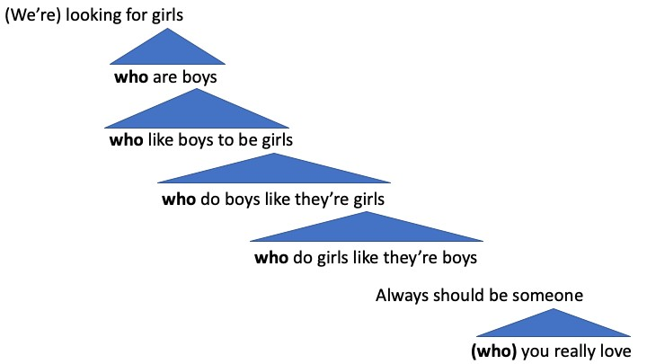
Girls who are boys. . .
Other dependent clauses
Nick Riches
Homework
Other types of DC
Adv. cl. recap Other types
DCs as comp. of vb.
Od and Oi position The SOMETHING test Cs and Co position EXERCISE
Subordinators EXERCISE
DCs in Subj.Posn.
Example
Heavy phrase shift EXERCISE
DCs in P-mod
What is a P-mod? Post-modifying clauses
Focus on RCs
Examples
Girls who are boys. . . Res./non-res. dist. Properties of RCs
Relative clauses in research EXERCISE
Homework ^{32 / 51}

Slide 48
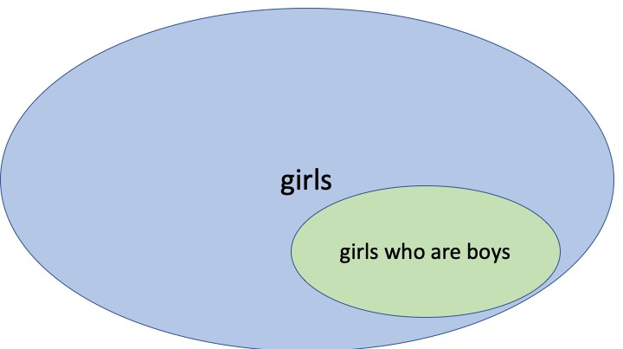
The restrictive / non-restrictive distinction
Other dependent clauses
Nick Riches
Restrictive relative clauses take a set of entities and restrict them.
Homework
Other types of DC
Adv. cl. recap Other types
DCs as comp. of vb.
Od and Oi position The SOMETHING test Cs and Co position EXERCISE
Subordinators EXERCISE
DCs in Subj.Posn.
Example
Heavy phrase shift EXERCISE
DCs in P-mod
What is a P-mod? Post-modifying clauses
Focus on RCs
Examples
Girls who are boys. . . Res./non-res. dist. Properties of RCs
Relative clauses in research EXERCISE
Homework ^{33 / 51}

Slide 49
The restrictive / non-restrictive distinction
Other dependent clauses
Nick Riches
Homework
Other types of DC
Adv. cl. recap Other types
DCs as comp. of vb.
Od and Oi position The SOMETHING test Cs and Co position EXERCISE
Subordinators EXERCISE
(22)
The Paris which is in Texas is warmer than the Paris which is in France (restrictive relative clauses)
(23)
Paris, which is the capital of France, is a lovely city (non-restrictive relative clauses)
DCs in Subj.Posn.
Example
Heavy phrase shift EXERCISE
DCs in P-mod
What is a P-mod? Post-modifying clauses
Focus on RCs
Examples
Girls who are boys. . . Res./non-res. dist. Properties of RCs
Relative clauses in research EXERCISE
Homework ^{34 / 51}

Slide 50
Properties of relative clauses
Other dependent clauses
Nick Riches
Homework
Other types of DC
Adv. cl. recap Other types
They are headed by a relative pronoun (who, that, which).
The can contain unusual word orders
DCs as comp. of vb.
Od and Oi position The SOMETHING test Cs and Co position EXERCISE
Subordinators EXERCISE
(e.g. There’s the cat_{OBJ} I_{SUBJ} saw_{VERB})
DCs in Subj.Posn.
Example
Heavy phrase shift EXERCISE
3. They can split Subjects from Verbs
The cat [ that chased the dog ] very fierce
was
DCs in P-mod
What is a P-mod? Post-modifying clauses
Focus on RCs
Examples
Girls who are boys. . . Res./non-res. dist. Properties of RCs
Relative clauses in research EXERCISE
Homework ^{35 / 51}

Slide 51
Properties of relative clauses
Other dependent clauses
Nick Riches
Homework
Other types of DC
Adv. cl. recap Other types
Case-marking on pronouns
DCs as comp. of vb.
Od and Oi position The SOMETHING test Cs and Co position EXERCISE
Subordinators EXERCISE
(24) She_{NOM} likes her_{ACC}
And relative pronouns
There’s the man
There’s the man
DCs in Subj.Posn.
Example
Heavy phrase shift EXERCISE
who/whom_{ACC}
he saw
who/whom_{NOM}
saw him
DCs in P-mod
What is a P-mod? Post-modifying clauses
Focus on RCs
Examples
Girls who are boys. . . Res./non-res. dist. Properties of RCs
Relative clauses in research EXERCISE
Homework ^{36 / 51}

Slide 52
Properties of relative clauses
Other dependent clauses
Nick Riches
Homework
Other types of DC
Adv. cl. recap Other types
Animacy distinction on pronouns
DCs as comp. of vb.
Od and Oi position The SOMETHING test Cs and Co position EXERCISE
Subordinators EXERCISE
(27) She likes it
And relative pronouns
DCs in Subj.Posn.
Example
Heavy phrase shift EXERCISE
There’s the man that/who I saw.
I found the money that/who I dropped.
DCs in P-mod
What is a P-mod? Post-modifying clauses
Focus on RCs
Examples
Girls who are boys. . . Res./non-res. dist. Properties of RCs
Relative clauses in research EXERCISE
Homework ^{37 / 51}

Slide 53
Properties of relative clauses
Other dependent clauses
Nick Riches
Homework
Other types of DC
Adv. cl. recap Other types
DCs as comp. of vb.
Od and Oi position The SOMETHING test Cs and Co position EXERCISE
Subordinators EXERCISE
Occasionally the relative pronoun can be omitted
(30) I found the money (that) I dropped
DCs in Subj.Posn.
Example
Heavy phrase shift EXERCISE
DCs in P-mod
What is a P-mod? Post-modifying clauses
Focus on RCs
Examples
Girls who are boys. . . Res./non-res. dist. Properties of RCs
Relative clauses in research EXERCISE
Homework ^{38 / 51}

Slide 54
Properties of relative clauses
Other dependent clauses
Nick Riches
Homework
Other types of DC
Adv. cl. recap Other types
‘Movement’ of the pronoun
DCs as comp. of vb.
Od and Oi position The SOMETHING test Cs and Co position EXERCISE
Subordinators EXERCISE
Movement
who
did you see t ?
(31)
DCs in Subj.Posn.
Example
Heavy phrase shift EXERCISE
Movement
There’s the man
who
he saw t
(32)
DCs in P-mod
What is a P-mod? Post-modifying clauses
Focus on RCs
Examples
Girls who are boys. . . Res./non-res. dist. Properties of RCs
Relative clauses in research EXERCISE
Homework ^{39 / 51}

Slide 55
Properties of relative clauses
Other dependent clauses
Nick Riches
Homework
Other types of DC
Adv. cl. recap Other types
DCs as comp. of vb.
Od and Oi position The SOMETHING test Cs and Co position EXERCISE
Subordinators EXERCISE
Unusual word orders
There’s the man who _{OBJ.} I _{SUBJ.} saw _{V.}
There’s the fish that _{OBJ.} she _{SUBJ.} ate _{V.}
DCs in Subj.Posn.
Example
Heavy phrase shift EXERCISE
DCs in P-mod
What is a P-mod? Post-modifying clauses
Focus on RCs
Examples
Girls who are boys. . . Res./non-res. dist. Properties of RCs
Relative clauses in research EXERCISE
Homework ^{40 / 51}

Slide 56
Properties of relative clauses
Other dependent clauses
Nick Riches
Homework
Other types of DC
Adv. cl. recap Other types
DCs as comp. of vb.
Od and Oi position The SOMETHING test Cs and Co position EXERCISE
Subordinators EXERCISE
Splitting subjects from verbs
(35) The cat [ that chased the dog ]
was
very fierce
DCs in Subj.Posn.
Example
Heavy phrase shift EXERCISE
DCs in P-mod
What is a P-mod? Post-modifying clauses
Focus on RCs
Examples
Girls who are boys. . . Res./non-res. dist. Properties of RCs
Relative clauses in research EXERCISE
Homework ^{41 / 51}

Slide 57
Relative clauses in research
Other dependent clauses
Nick Riches
Homework
Other types of DC
Adv. cl. recap Other types
Relative clauses are very widely used in linguistic research because:
DCs as comp. of vb.
Od and Oi position The SOMETHING test Cs and Co position EXERCISE
Subordinators EXERCISE
They vary in interesting ways across languages
In some languages they allow you create simple and complex versions of the same sentence WITHOUT MAKING ANY CHANGES TO THE WORDS IN THE SENTENCE
They are very sensitive to overall linguistic ability. Language-impaired individuals find relative clauses particularly difficult to process.
DCs in Subj.Posn.
Example
Heavy phrase shift EXERCISE
DCs in P-mod
What is a P-mod? Post-modifying clauses
Focus on RCs
Examples
Girls who are boys. . . Res./non-res. dist. Properties of RCs
Relative clauses in research EXERCISE
Homework ^{42 / 51}

Slide 58
Relative clauses in research
Other dependent clauses
Nick Riches
Homework
Other types of DC
Adv. cl. recap Other types
DCs as comp. of vb.
Od and Oi position The SOMETHING test Cs and Co position EXERCISE
Subordinators EXERCISE
(36)
There’s the dog that chased the cat
(37)
There’s the cat that the dog chased
DCs in Subj.Posn.
Example
Heavy phrase shift EXERCISE
DCs in P-mod
What is a P-mod? Post-modifying clauses
Focus on RCs
Examples
Girls who are boys. . . Res./non-res. dist. Properties of RCs
Relative clauses in research EXERCISE
Homework ^{43 / 51}

Slide 59
Relative clauses in research
Other dependent clauses
Nick Riches
Homework
Other types of DC
Adv. cl. recap Other types
DCs as comp. of vb.
Od and Oi position The SOMETHING test Cs and Co position EXERCISE
Subordinators EXERCISE
(38)
There’s
the dog
that chased the cat
(39)
There’s
the cat
that the dog chased
DCs in Subj.Posn.
Example
Heavy phrase shift EXERCISE
DCs in P-mod
What is a P-mod? Post-modifying clauses
Focus on RCs
Examples
Girls who are boys. . . Res./non-res. dist. Properties of RCs
Relative clauses in research EXERCISE
Homework ^{44 / 51}

Slide 60
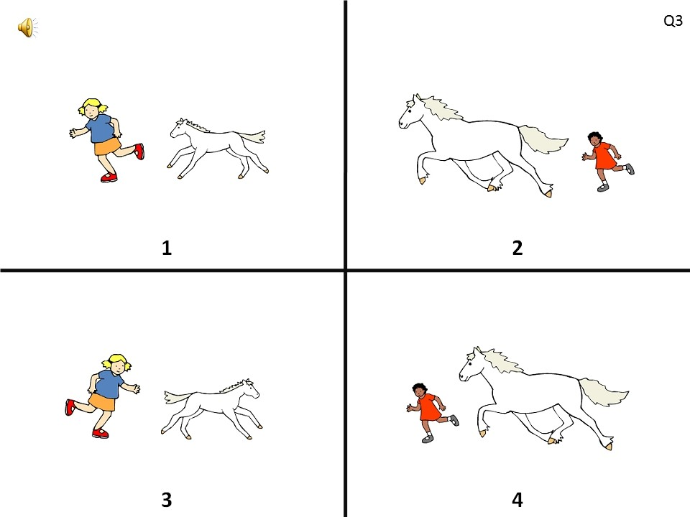
Relative clauses in research
Other dependent clauses
Test of Reception of Grammar
The girl that’s chasing the horse is big
Nick Riches
Homework
Other types of DC
Adv. cl. recap Other types
DCs as comp. of vb.
Od and Oi position The SOMETHING test Cs and Co position EXERCISE
Subordinators EXERCISE
DCs in Subj.Posn.
Example
Heavy phrase shift EXERCISE
DCs in P-mod
What is a P-mod? Post-modifying clauses
Focus on RCs
Examples
Girls who are boys. . . Res./non-res. dist. Properties of RCs
Relative clauses in research EXERCISE
Homework ^{45 / 51}

Slide 61
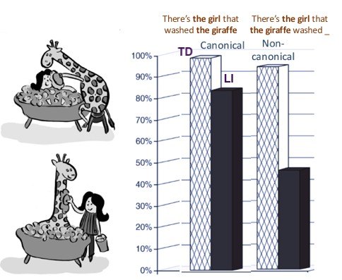
Relative clauses in research
Other dependent clauses
Nick Riches
Novogrodksy & Friedmann, 2006.
Homework
Other types of DC
Adv. cl. recap Other types
DCs as comp. of vb.
Od and Oi position The SOMETHING test Cs and Co position EXERCISE
Subordinators EXERCISE
DCs in Subj.Posn.
Example
Heavy phrase shift EXERCISE
DCs in P-mod
What is a P-mod? Post-modifying clauses
Focus on RCs
Examples
Girls who are boys. . . Res./non-res. dist. Properties of RCs
Relative clauses in research EXERCISE
Homework ^{46 / 51}

Slide 62
EXERCISE
Other dependent clauses
Nick Riches
Homework
Other types of DC
Adv. cl. recap Other types
Rewrite the following sentences using relative clauses
DCs as comp. of vb.
Od and Oi position The SOMETHING test Cs and Co position EXERCISE
Subordinators EXERCISE
The man wore a hat. He had a beard
The policeman chased the dog. It was carrying sausages.
The boy won the lottery. His cat was run over.
The park bench has been vandalised. I first kissed my girlfriend there.
DCs in Subj.Posn.
Example
Heavy phrase shift EXERCISE
DCs in P-mod
What is a P-mod? Post-modifying clauses
Focus on RCs
Examples
Girls who are boys. . . Res./non-res. dist. Properties of RCs
Relative clauses in research EXERCISE
Homework ^{47 / 51}

Slide 63
EXERCISE
Other dependent clauses
Nick Riches
Homework
Other types of DC
Adv. cl. recap Other types
The man [_{Relative Cl.} that had a beard] wore a hat
DCs as comp. of vb.
Od and Oi position The SOMETHING test Cs and Co position EXERCISE
Subordinators EXERCISE
DCs in Subj.Posn.
Example
Heavy phrase shift EXERCISE
DCs in P-mod
What is a P-mod? Post-modifying clauses
Focus on RCs
Examples
Girls who are boys. . . Res./non-res. dist. Properties of RCs
Relative clauses in research EXERCISE
Homework ^{48 / 51}

Slide 64
EXERCISE
Other dependent clauses
Nick Riches
Homework
Other types of DC
Adv. cl. recap Other types
The man [_{Relative Cl.} that had a beard] wore a hat
DCs as comp. of vb.
Od and Oi position The SOMETHING test Cs and Co position EXERCISE
Subordinators EXERCISE
The policement chased the dog [ that was carrying sausages]
Relative Cl.
DCs in Subj.Posn.
Example
Heavy phrase shift EXERCISE
DCs in P-mod
What is a P-mod? Post-modifying clauses
Focus on RCs
Examples
Girls who are boys. . . Res./non-res. dist. Properties of RCs
Relative clauses in research EXERCISE
Homework ^{48 / 51}

Slide 65
EXERCISE
Other dependent clauses
Nick Riches
Homework
Other types of DC
Adv. cl. recap Other types
The man [_{Relative Cl.} that had a beard] wore a hat
DCs as comp. of vb.
Od and Oi position The SOMETHING test Cs and Co position EXERCISE
Subordinators EXERCISE
The policement chased the dog [ that was carrying sausages]
Relative Cl.
The boy [ lottery
Relative Cl.
whose cat was run over] won the
DCs in Subj.Posn.
Example
Heavy phrase shift EXERCISE
DCs in P-mod
What is a P-mod? Post-modifying clauses
Focus on RCs
Examples
Girls who are boys. . . Res./non-res. dist. Properties of RCs
Relative clauses in research EXERCISE
Homework ^{48 / 51}

Slide 66
EXERCISE
Other dependent clauses
Nick Riches
Homework
Other types of DC
Adv. cl. recap Other types
The man [_{Relative Cl.} that had a beard] wore a hat
DCs as comp. of vb.
Od and Oi position The SOMETHING test Cs and Co position EXERCISE
Subordinators EXERCISE
The policement chased the dog [ that was carrying sausages]
Relative Cl.
The boy [ lottery
The park bench [_{Relative Cl.} where I first kissed my girlfriend] has been vandalised
Relative Cl.
whose cat was run over] won the
DCs in Subj.Posn.
Example
Heavy phrase shift EXERCISE
DCs in P-mod
What is a P-mod? Post-modifying clauses
Focus on RCs
Examples
Girls who are boys. . . Res./non-res. dist. Properties of RCs
Relative clauses in research EXERCISE
Homework ^{48 / 51}

Slide 67
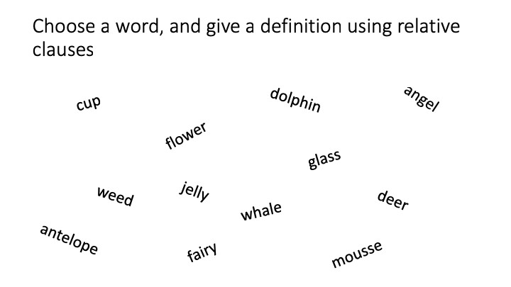
EXERCISE
Other dependent clauses
Nick Riches
Homework
Other types of DC
Adv. cl. recap Other types
DCs as comp. of vb.
Od and Oi position The SOMETHING test Cs and Co position EXERCISE
Subordinators EXERCISE
DCs in Subj.Posn.
Example
Heavy phrase shift EXERCISE
DCs in P-mod
What is a P-mod? Post-modifying clauses
Focus on RCs
Examples
Girls who are boys. . . Res./non-res. dist. Properties of RCs
Relative clauses in research EXERCISE
Homework ^{49 / 51}

Slide 68
Other dependent clauses
Nick Riches
Homework
Other types of dependent clause
Homework
Other types of DC
Adv. cl. recap Other types
Dependent clauses as a complement of the verb (Od, Oi, Cs, Co)
DCs as comp. of vb.
Od and Oi position The SOMETHING test Cs and Co position EXERCISE
Subordinators EXERCISE
Dependent clauses in Subject Position
Dependent clauses in Post-modifer Position
DCs in Subj.Posn.
Example
Heavy phrase shift EXERCISE
Focus on relative clauses Homework
DCs in P-mod
What is a P-mod? Post-modifying clauses
Bibliography
Focus on RCs
Examples
Girls who are boys. . . Res./non-res. dist. Properties of RCs
Relative clauses in research EXERCISE
Homework ^{49 / 51}

Slide 69
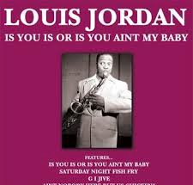
What is unusual about the popular song lyric ‘Is you is, or is you ain’t my baby?’
Other dependent clauses
Nick Riches
Homework
Other types of DC
Adv. cl. recap Other types
DCs as comp. of vb.
Od and Oi position The SOMETHING test Cs and Co position EXERCISE
Subordinators EXERCISE
DCs in Subj.Posn.
Example
Heavy phrase shift EXERCISE
DCs in P-mod
What is a P-mod?
Post-modifying clauses
Focus on RCs
Examples
Girls who are boys. . . Res./non-res. dist. Properties of RCs
Relative clauses in research EXERCISE
Homework ^{50 / 51}

Slide 70
Other dependent clauses
Nick Riches
Homework
Other types of dependent clause
Homework
Other types of DC
Adv. cl. recap Other types
Dependent clauses as a complement of the verb (Od, Oi, Cs, Co)
DCs as comp. of vb.
Od and Oi position The SOMETHING test Cs and Co position EXERCISE
Subordinators EXERCISE
Dependent clauses in Subject Position
Dependent clauses in Post-modifer Position
DCs in Subj.Posn.
Example
Heavy phrase shift EXERCISE
Focus on relative clauses Homework
DCs in P-mod
What is a P-mod?
Post-modifying clauses
Bibliography
Focus on RCs
Examples
Girls who are boys. . . Res./non-res. dist. Properties of RCs
Relative clauses in research EXERCISE
Homework ^{50 / 51}

Slide 71
Other dependent clauses
Nick Riches
Homework
Other types of DC
Adv. cl. recap Other types
Novogrodsky, R., & Friedmann, N. (2006). The production of relative clauses in syntactic SLI: A window to the nature of the impairment. International Journal of
Speech-Language Pathology, 8(4), 364-375. https://doi.org/10.1080/14417040600919496
Riches, N. G. (2012). Sentence repetition in children with specific language impairment: An investigation of underlying mechanisms. International Journal of Language & Communication Disorders, 47(5), 499-510. https://doi.org/10.1111/j.1460-6984.2012.00158.x
DCs as comp. of vb.
Od and Oi position The SOMETHING test Cs and Co position EXERCISE
Subordinators EXERCISE
DCs in Subj.Posn.
Example
Heavy phrase shift EXERCISE
DCs in P-mod
What is a P-mod? Post-modifying clauses
Focus on RCs
Examples
Girls who are boys. . . Res./non-res. dist. Properties of RCs
Relative clauses in research EXERCISE
Homework ^{51 / 51}

